Slide 1
Securing your Infrastructure with Azure Sentinel
Subtitle or speaker name
Notes:
Welcome to Securing your Infrastructure with Azure Sentinel.
My name is [Speaker name].

Slide 2
Agenda
Azure Sentinel data
Analytics
Visualize
Security orchestration
Notes:
Today we'll be running through Azure Sentinel from a few different lenses. If you've already deployed Azure Sentinel, some of this might be a repeat but I'll call out best practices where possible.
We'll start with Azure Sentinel data, including data storage in Log Analytics and how to approach workspace design in both a single tenant and multi-tenant environment. Next we'll cover the various sources of data that are available for ingestion into Log Analytics and analysis through Azure Sentinel and how that data can be encrypted.
Then, we'll talk about what you can do with your data once it's being ingested into Log Analytics. This includes leverage built-in detection rules and creating your own custom rule templates.
After that, we'll review visualizations and what you can do with Workbooks in Sentinel.
And finally, we'll close with Security Orchestration, Automation and Response, or SOAR.

Slide 3
Azure Sentinel data
Notes:
Let's get started with Azure Sentinel data sources.

Slide 4
Workspace considerations
Tenant
Single
Multiple
Data governance
Costs
Bandwidth
Storage
Notes:
The first thing we need to think about before we enable Sentinel is what workspace (or workspaces!) it is going to be enabled in. There's a lot of nuance here with single vs multi-tenant considerations and how data is governed and how costs manifest for both bandwidth and storage across your solution stack.
If you have multiple workspaces for performance, resiliency, or data sovereignty – are there any pitfalls to incident or alert correlation you need to be aware of? As you onboard other solutions or even as new functionality is added to existing solutions like Azure Security Center you need to understand where that data is going to reside and if it generates incidents, how are you going to keep the alert noise low?
Let's talk about some best practices that have been learned from existing customers.

Slide 5


Workspace Design (Single Tenant) One single workspace per tenant – many customers do this today!
Pros
Central pane of glass
Consolidates all security logs and information
Easier to query all information
Supported by all features of Azure Sentinel
Azure Log Analytics RBAC to control data access
Azure Sentinel RBAC for service RBAC
Cons
Data governance may drive limited scope
Can incur bandwidth cost cross region
Notes:
With all of the data for Sentinel ultimately stored in Log Analytics underneath, let's talk about workspace design in two contexts starting with single tenant.
Single tenant covers the majority of customers today. <click>
Let's start with the Pros. First, you'll get a single, central pane of glass. With all of your security logs and information consolidated into a single workspace, authoring queries becomes much easier and you don't need to worry about consistency in solution deployment and workspace schema getting in the way like you would with cross workspace queries – it's not that cross workspace queries can't be done – it's just that there's potentially more to know about KQL and the underlying workspaces you want to query.
Next, it's supported by all of the features of Azure Sentinel and you can control access to both Sentinel and the underlying Log Analytics data store using standard Azure RBAC. For Azure Sentinel, you can use built in roles like Owner, Contributor and Reader but there are also specialized roles such as Azure Sentinel Reader, Azure Sentinel Responder, and Azure Sentinel Contributor.
Log Analytics also has its own specialized roles, including Log Analytics Reader and Log Analytics Contributor. You can use the Log Analytics advanced role-based access control across the data in your Azure Sentinel workspace. This includes both role-based access control per data type and resource-centric role-based access control.
Keep in mind that other resources may be external to Sentinel and Log Analytics which drive how you use Sentinel. For example, if you leverage playbooks (which if you don't you should!) run in Azure Logic Apps. For that you'll want to look into the Logic App Contributor and Logic App Operator role assignments.
<click> On the Cons side, data governance can lead you to design multiple workspaces, with one of the most prevalent examples being data sovereignty. You should also consider data egress. For example, if you have Azure VMs in a region sending telemetry and operational data to a central workspace in another region, you will need to account for data egress charges.

Slide 6
Workspace Design (Single Tenant) Regional workspaces
Pros
No cross-region bandwidth cost
May be required to meet regulation requirements
Separate workspaces can add even more data control
Cons
No central pane of glass
Analytics, Workbooks, etc. must be deployed multiple times
Notes:
Now let's consider another model with regional workspaces, again if you need meet a compliance requirement or even if you have varying RBAC needs on a workspace-by-workspace basis.
<click> On the Pros – there's no cross-region workspace charges, you get far more granular control over who can access what data, and perhaps most importantly you'll be meeting the regulatory needs of the business if required.
<click> There are some cons here though. One of the most obvious is you'll lose the single pane of glass. Another consideration is you'll potentially have multiple analytics rules. Analytics rules cannot query across workspaces so you if you want the same rule logic in multiple places, you'll need to duplicate it. Workbooks, both Azure and Jupyter and hunting across multiple workspaces is possible today.
There is a community driven PowerShell module which can help you create analytics rules and publish them to multiple workspaces using the Sentinel API if this is a path that you need to go down.

Slide 7
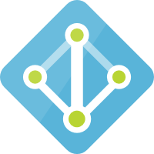




Workspace Design (Single Tenant)
Tenant
Tenant
Subscription
Subscription
Resource Group
Resource Group Region A
Resource Group Region B
Workspace
Azure Sentinel
Workspace
Azure Sentinel
Workspace
Azure Sentinel
Notes:
Let's run through what that would look like.
<click> For the first model, everything is very straightforward and clean – single workspace, single Sentinel resource, single resource group and single subscription.
<click> In the 2nd model, you're still single tenant but you now have multiple workspaces, multiple instances of Sentinel, and multiple resource groups. You could extend this further and even go for multi-subscription all under the same tenant.

Slide 8
What if I have multiple tenants?
Contoso |  |  |  |  | Northwind |  |  |  | Coho Winery
 |  |  |  |  | CENTRAL & SW | Prod. |  |  | Prod. | Staging | Test | Dev.
SALES, MKTG, & SERVICE |  | Prod. | QA | Dev. | EAST | Prod. |  |  | Prod. | Staging | Test | Dev.
LEGAL |  | Prod. | QA | Dev. | INCUBATION TEAM | Prod. |  |  | Prod. | Staging | Test | Dev.
HR |  | Prod. | QA | Dev. | NORTHWEST | Prod. | QA | Dev. | Prod. | Staging | Test | Dev.
Fabrikham |  |  |  |  | Proseware |  |  |  | Prod. | Staging | Test | Dev.
 |  |  |  |  |  |  |  |  | Prod. | Staging | Test | Dev.
VENDOR MGMT | Prod. | Training | Test | Dev. | VENDOR MGMT FOR REAL ESTATE | Prod. | Test/Dev. |  | Prod. | Staging | Test | Dev.
RETAIL | Prod. | Training | Test | Dev. | RETAIL | Prod. | Test/Dev. |  | Prod. | Staging | Test | Dev.
WEALTH MGMT | Prod. | Training | Test | Dev. | WEALTH MGMT | Prod. | Test/Dev. |  | Prod. | Staging | Test | Dev.
Notes:
This begs the question – What if I have multiple tenants with multiple subscriptions and multiple workloads? This muddies the waters, but it can still be accommodated easily using multi-tenant management features of Azure such as Azure Lighthouse.

Slide 9
Workspace Design (Multi-Tenant) One workspace per tenant Use Azure Lighthouse to delegate access to the central tenant
Pros
Same as single workspace single tenant
Cons
No single pane across all tenants
Notes:
So, for multi-tenant the easiest and recommended approach is to go with one workspace per-tenant and then use Azure Lighthouse to delegate access to that tenant.
<click> Your Pro here is you get the same setup as a single workspace with a single tenant, <click> with a downside of you won't have a single or central pane of glass across all of the tenants that you have delegated access to.

Slide 10
Workspace Design (Multi-Tenant)
Optional, but not recommended
Ship logs from each tenant to a central tenant
Source → Event Hub → Logic App → Azure Log Analytics
https://docs.microsoft.com/azure/azure-monitor/platform/activity-log-collect-tenants
Incur costs for Event Hubs & Logic Apps
Data written via Logic App will be stored in a Custom Log (_CL)
Queries will have to be changed to support _CL
Notes:
There are some things you can do to bring the data to a single tenant – this is optional but is not recommended if you can avoid it most due to cost. It introduces operational overhead, potentially having to do custom development, and more.
If you do go down this path, you'll send up sending data from one or more source systems to an Event Hub, where it can them be processed by a Logic App or another custom application and then forwarded on to the centralized Log Analytics workspace.
Beyond the costs you'll incur for both Event Hubs and Logic Apps, also consider the cost of storing the data multiple times – in the source system and maybe even a source Log Analytics workspace and then having it all duplicated to yet another workspace. And once again, don't forget about data egress.
Also consider that your telemetry will likely end up in a table for your custom logs. Custom Logs have _CL as a suffix on their table name and none of the built-in queries in Azure Sentinel for analytics rules or workbooks will be configured to point to custom tables. This means you will likely have to do a large mount of customization to existing queries or build custom queries to interrogate the logs in your custom table(s) within the Log Analytics workspace associated with Sentinel.
Again, this is not recommend, but it is possible.

Slide 11
Workspace Design (Multi-Tenant)
Tenant A
Tenant B
Tenant C
Subscription
Subscription
Subscription
Resource Group
Resource Group
Resource Group
Workspace
Azure Sentinel
Workspace
Azure Sentinel
Workspace
Azure Sentinel
Azure Lighthouse
Notes:
So what does this look like?
Each tenant gets its own workspace and you'll be granted delegated permissions through Azure Sentinel to be able to interact with each workspace. Note that in this model, multiple tenants could be multiple customers where each customer has their own tenant, or it could be a single customer who has provisioned multiple tenants in order to accommodate the business.

Slide 12



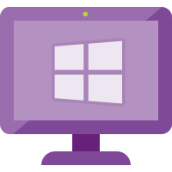
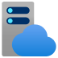

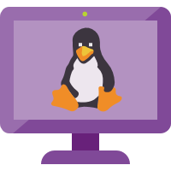
All the ways data gets in
Custom App
Appliances (Integrated)
Logic App – Send Data Connector
PUSH
Rest API
Threat Intelligence
(via Graph Security API)
MISP, Palo Alto….
Cloud Services
w/ Connector
O365, MCAS, AATP, MDATP, AWS
Workspace
Azure Sentinel
PULL
PUSH
Azure Services
(Diagnostic Logs)
AAD, AAD IP, Azure Activity, AIP, ASC, AzWAF, …
PUSH
Windows Agent
Linux Agent
Linux Agent – Configured for CEF
Appliances (CEF)
PUSH
Notes:
Now let's run through data connectors and all of the ways that you can ingest data into Azure Sentinel.
First, we have the Log Analytics workspace which has Azure Sentinel enabled on it.
<click> For Cloud services you'll find many connectors for Office 65, Microsoft Cloud App Security, Azure Advanced Threat Protection, and even external clouds like AWS. Cloud connectors are built-in to Azure Sentinel and can be easily enabled. Once enabled, Sentinel will regularly pull data from the external entity into your connected workspace. All of the connections leverage modern authentication and supported vendor APIs for data retrieval.
<click> Next we have Azure services. You'll find connectors for common services like the Azure Activity Log and Azure AD Sign-in Logs. Note that some connectors such as the Azure AD Sign-in logs do require access to premium licensing in Azure AD. For some services, you may not see a direct connector but if the diagnostic settings for the resource support sending data to Log Analytics then you can certainly ingest the data into your target workspace and then create queries, custom analytics rules, and queries as needed. Note that this is a push model from the source.
<click> Next we have the Azure Log Analytics agent which is available for both Windows and Linux servers and clients. This agent goes by a number of names – The Log Analytics agent, the Microsoft Monitoring Agent or MMA, and the OMS Linux agent. These also operate on a push model, with the clients through the agent writing data to a connected workspace.
<click> There's also a Linux agent which is available for collecting Common Event Format, or CEF data from appliances. Note that you'll see connectors for common appliances such as Palo Alto or Fortinet next gen firewalls with connectors through Sentinel. These connectors actually use CEF and the forwarding Linux agent to get the data from the appliance into Azure.
<click> There are also a decent number of integrated appliances such as F5 which offers a direct integration with the Sentinel REST API to send data from the appliance to Log Analytics. Many vendors like F5 have chosen to create simple add-ons where you can enable the app, enter your workspace ID and provide an access key and it will begin sending data to Sentinel immediately.
<click> There's also the Threat Intelligence connectors available through the Microsoft Graph Security API which can be used to push threat intelligence data into your connected workspace. There is also a TAXII connector which supports the STIX format.
<click> And finally, as I mentioned you have REST APIs available to interact with Log Analytics and Sentinel that you can use from your own custom applications. It's relatively quick to wire up Logic Apps or your customer apps to write your custom logs into Log Analytics.

Slide 13
Data collectors (quick wins)
Enable 1st-party Connectors that are running in the environment
Most are free
O365
Azure Activity
1st Party Alerts – MCAS, AATP, MDATP, AAD IP, …
Connect AWS
Connect / Configure Azure Diagnostic Logs (Policy)
Deploy Windows/Linux Agent in Azure (built-in Policy)
Notes:
Here's a few tips for wiring up and configuring your data connectors for quick wins. Now, this isn't just to get a body of data ingested into Sentinel that you're not going to use, but if you do use any of the services mentioned here, wiring up the connector is quick and you can start not just gaining insights into your posture, but make those insights actionable.
If you do happen to use another public cloud such as AWS, you can quickly begin to ingest your CloudTrail logs by creating a custom role in in your AWS subscription that has the AWSCloudTrailReadOnlyAccess permission policy attached to it and granting Microsoft's Account ID to the role. When you add the external user, you'll be given the opportunity to enter the Workspace ID from the target Sentinel workspace.
I also can't stress enough that almost ever server uses diagnostic logs in one form or another and you can also quickly enable diagnostic log collection with Azure Policy. Which policy assignments at the Management group scope, you can quickly enable diagnostic settings for 30 plus Azure services. Just go in and search for built-in polices that start with "Diagnostic logs in" and end with "should be enabled". For example, Diagnostic logs in Key Vault should be enabled, or Diagnostic logs in IoT Hub should be enabled.
You can also use built-in policy to deploy the Log Analytics agent to your VMs hosted in Azure. Note that it is an agent, and while it is built to be performant, it can have a slight impact, especially on smaller VMs that generate large amounts of telemetry.

Slide 14
Data collectors (next steps)
Deploy Windows/Linux Agent
On-premises
Other clouds
Deploy CEF Collection
Configure CEF collector using configuration script
Configure source devices – ensure they support RFC and CEF
See the “Grand List” https://techcommunity.microsoft.com/t5/Azure-Sentinel/Azure-Sentinel-The-Syslog-and-CEF-source-configuration-grand/ba-p/803891
Integrate Threat Intelligence
Ask vendors to directly integrate!
Notes:
Certainly, if you have physical or virtual machines on-premises or in other clouds, those can be onboarded to Log Analytics as well, I would even extend this to think about collecting data from other compute driven workloads such as OpenShift or on-premises Kubernetes clusters using Azure Monitor for containers.
If you need to collect CEF logs and your appliance does not have a native integration with Sentinel, you'll need to deploy the CEF collector. The CEF collector acts as a proxy, collecting CEF logs and forwarding them to the target workspace. The current collector agent is supported on both 32 and 64 bit servers and runs on a number of Linux distributions, including CentOS, RHEL, Ubuntu, Debian, and Oracle. The CEF collector supports syslog RFC 3164 and RFC 5424. Because the collector runs on a machine that is external to the appliances you are sending logs from, you'll need to configure the syslog agent on the Collector per your organizations security requirements such as implementing TLS for your syslog configuration.
Microsoft maintains a list (referred to as the grand list) of Logstash, Sentinel data collection API, custom, and CEF connectors over in the Tech Community. For example, if you are working with CyberArk Privileged Access Security and want quick links to supported message formats and instructions for implementation, you might want to stop here before you go to the docs. As the Sentinel Product Group works with new vendors and as new solutions are documented the list is maintained.
Finally, if you find yourself working with a vendor and they don't support Sentinel directly today, ask them to integrate. I can't stress enough there are stable APIs for ISVs hardware vendors to use.

Slide 15

CEF architecture
On prem
On prem
Syslog source
Syslog source
Syslog
Over UDP, TCP, or TLS default port: 514
Azure
Syslog source
Azure
Syslog source
Syslog agent
Syslog agent
Syslog source
Syslog daemon
(rsylog.d and syslog-ng)
Azure Sentinel agent
Azure Sentinel workspace
Syslog daemon
(rsylog.d and syslog-ng)
Azure Sentinel agent
Azure Sentinel workspace
Syslog source
UDP port: 25226
Restful API over TLS port: 443
UDP port 25226
Syslog source
Syslog source
Notes:
I've already mentioned the CEF collector, but let's talk about where it can sit in your environment.
<click> The first scenario would be all on-premises, with your syslog sources sending logs to the syslog daemon on the collector and the collector agent taking those logs and sending them to Azure Log Analytics.
Remember, that the connection to Log Analytics is an HTTPS Connection on port 433. This means your logs will traverse the public internet unless you have implemented ExpressRoute and have a Microsoft peering path in place.
<click> Next, we have the scenario where you maintain your on-premises syslog sources, but you keep the syslog daemon and collector in Azure. In this case, once the logs hit your collector, they're sent to Log Analytics over the MS backbone. Your logs however will still traverse the public internet unless you have a Site to Site VPN connection or ExpressRoute in place. And keep in mind that your syslog logs are in plane text. You'll want to implement some type of firewall to ensure that only known sources can send logs to the collector. You don't want a bad actor sending malformed logs to the collector and introducing data that goes in a different direction than your source of truth.

Slide 16
Customer-managed key
All data saved or sent to Sentinel can be encrypted with CMK
Only available to new customers
Request at azuresentinelCMK@microsoft.com
Limited regions
East US
West US 2
South Central US
Larger workloads
1TB per-day or more of data ingested in Sentinel
Notes:
Now I'd like a spend a moment on Customer Managed Key for Sentinel. We've talked a lot about your data being stored in a Log Analtyics workspace with Sentinel enabled, but not how to protect that data outside of Azure RBAC.
CMK enables all data saved or sent to Azure Sentinel to be encrypted in all relevant storage resources with an Azure Key Vault key created or owned by you or your customers. In the event that a user revokes the key encryption key, either by deleting it or removing access for Azure Sentinel, within one hour, Azure Sentinel will honor the change and behave as if the data is no longer available. At this point, any operation performed that uses persistent storage resources such as data ingestion, persistent configuration changes, and incident creation, will be prevented. Previously stored data will not be deleted but will remain inaccessible. Inaccessible data is governed by the data-retention policy and will be purged in accordance with that policy. The only operation possible after the encryption key is revoked or deleted is account deletion. If access is restored after revocation, Azure Sentinel will restore access to the data within an hour. You can also rotate keys by creating a new version of the key and within an hour Sentinel will begin using the new version.
CMK is provided only to customers who are new and access to this capability is controlled by Azure feature registration. You can request access by contacting azuresentinelCMK@microsoft.com, and as capacity is available, pending requests will be approved.
The Azure Sentinel CMK capability is only available in East US, West US 2, and South Central US regions and the CMK capability is only available to customers sending 1TB per day or more.
With CMK, you'll be encrypting the contents of the Log Analytics workspace Sentinel is enabled in as well as all of the other associated resources such as storage accounts for diagnostics storage collection with a key managed in Azure Key Vault.

Slide 17
Demo
Azure Sentinel connectors
Notes:
Let's take a look at Azure Sentinel and the current connector landscape.

Slide 18
Analytics
Notes:
Next let's talk analytics. Once we have data flowing in, we can query and action it.

Slide 19

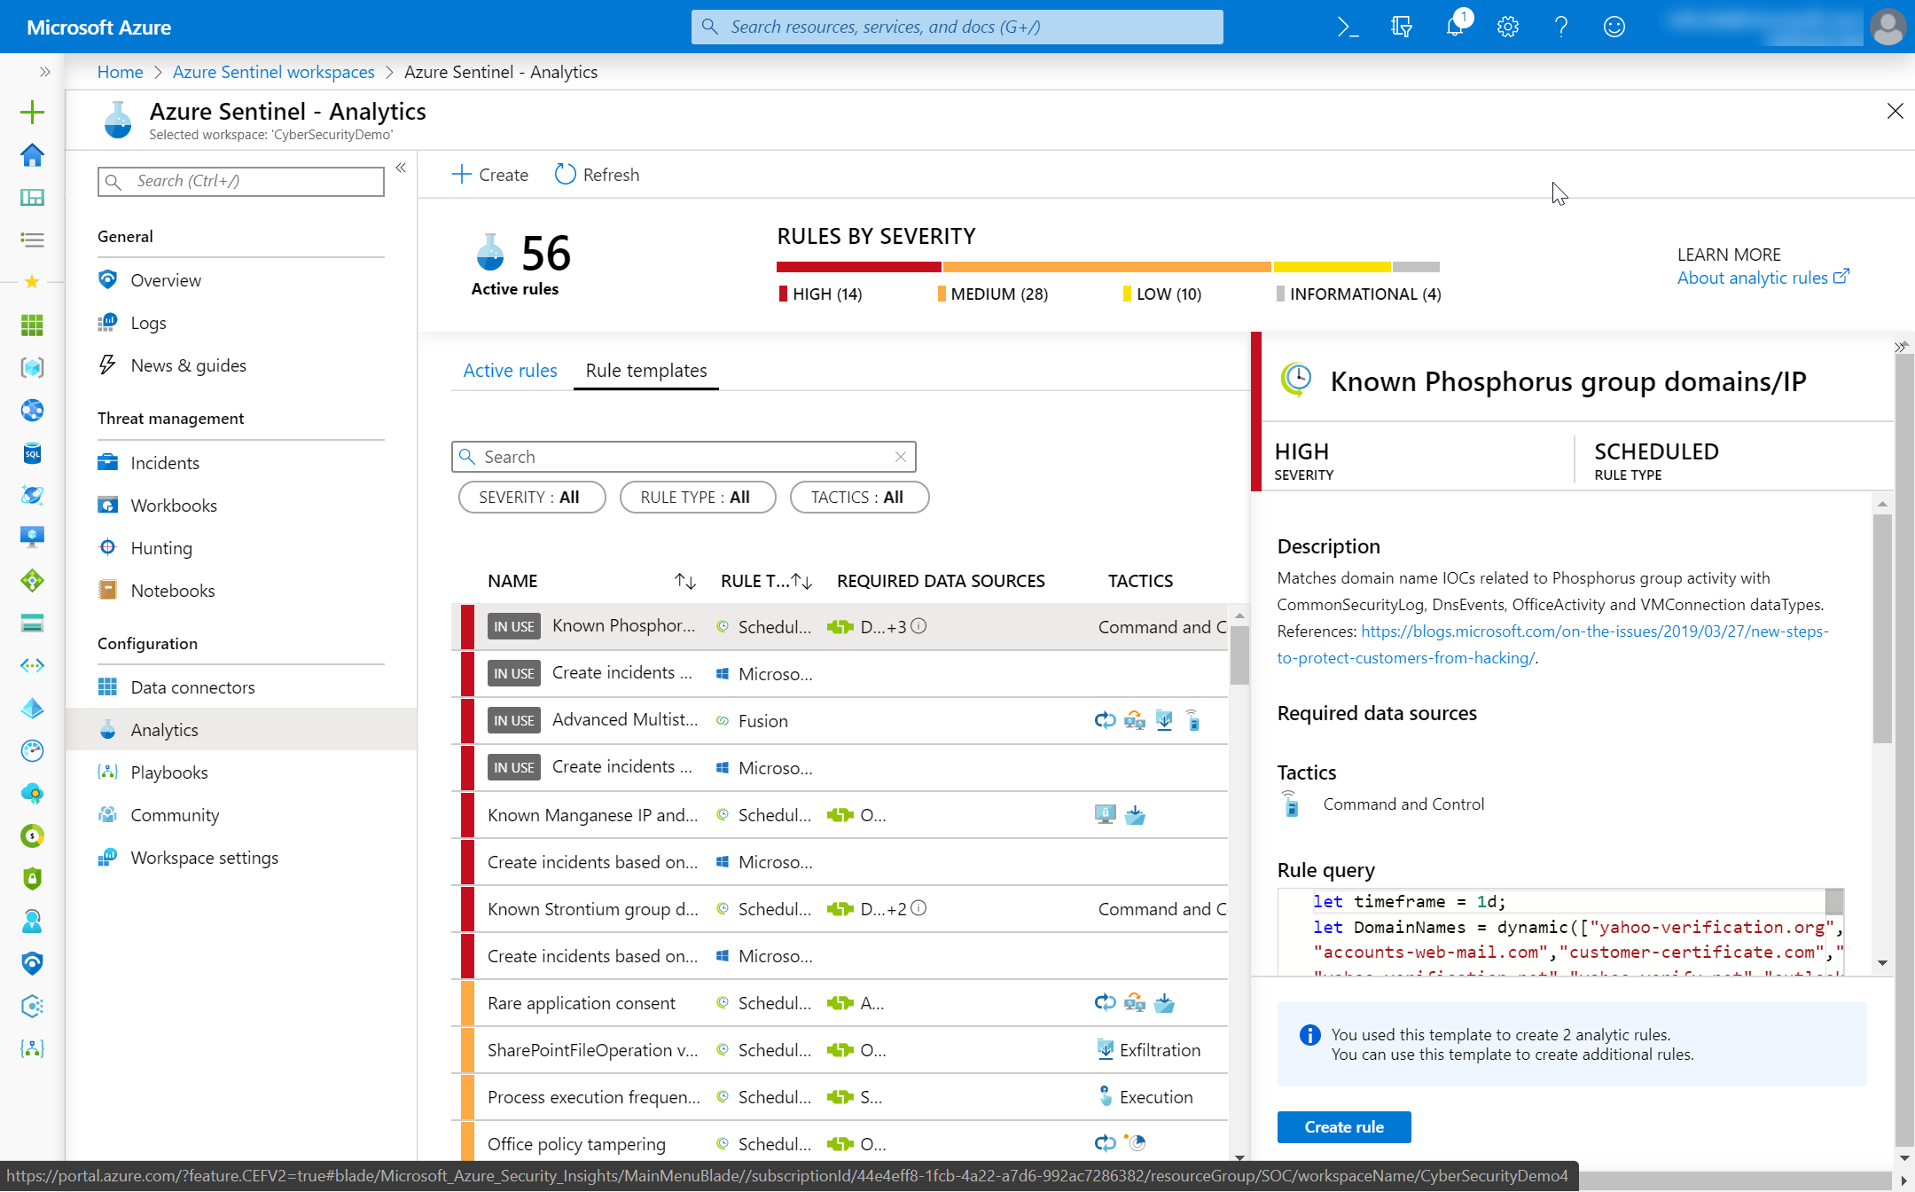
Analytics
You got data… now what?
Create Analytics to detect suspicious activity!
Enable Microsoft Security rules
Enable built-in rules
Use GitHub
Build custom detections
Notes:
Once you have data flowing into Azure Sentinel and you've started to gain insights from the built-in workbooks, you can start to enable detections on top of this data.
More than 100 built-in analytics alert rules that have been developed by Microsoft and community security experts. You can also customize and create your own rules using KQL and a wizard is provided, although you'll probably find that to get the most out of Sentinel you do need to know KQL.
You can correlate events with your threat intelligence and now with Microsoft intel based on your detection rules. Microsoft has an unparalleled view of evolving threat landscape for both basic and advanced scenarios and the built-in detection rules can provide immediate value in every environment. There are known malicious URL rules which customers can use to match Microsoft URL threat intelligence with network.
For built-in rules matched MS indicators are added to the threat intelligence table for use like any other indicator. There are retrospective lookbacks that match incoming threat intelligence data against historical event data and as a cloud-native service more types are added automatically.
Thresholds can be set to alert when activity levels exceed normal patterns and any detection alert can be used to trigger automated playbooks.

Slide 20
Demo
Microsoft incident creation rules

Slide 21
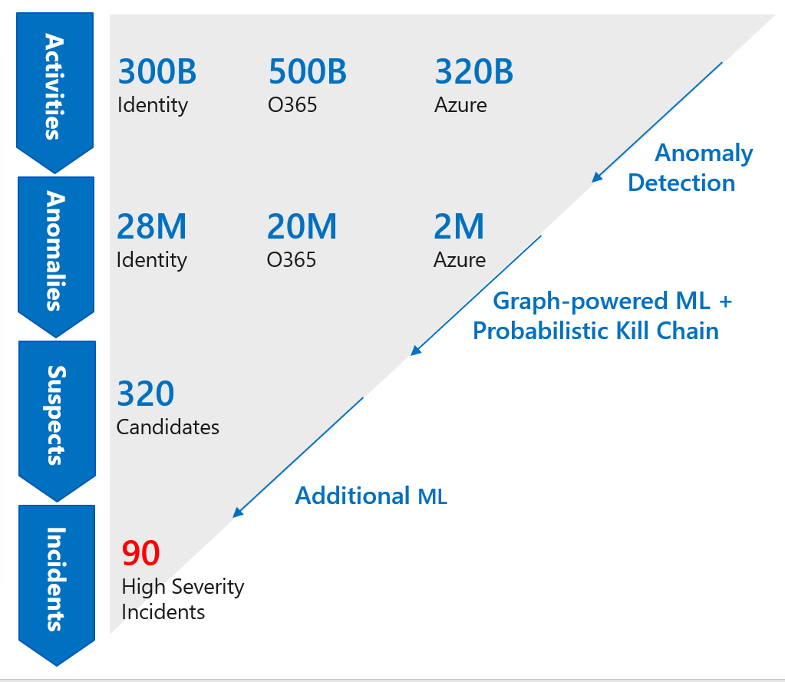
Increase your catch rate
Use built–in models – no ML experience required
Detects anomalies using transferred learning
Fuses data sources to detect threats that span the kill chain
Simply connect your data and learning begins
Notes:
The built-in detections in Azure Sentinel leverage machine learning, or ML. The built–in models offer the benefits of ML without the complexity and increase the catch rate without increasing the noise.
There are a few models I'd like to call out.
One offers proven off-the-shelf Machine Learning models for identifying suspicious logins across Microsoft identity services to discover malicious or anonymous SSH access in your environment. By using transferred learning from existing Machine Learning models, Azure Sentinel can detect anomalies from a single dataset with accuracy.
In addition, we use a Machine Learning technique called fusion to connect data from multiple sources, like Azure AD anomalous logins and suspicious Office 365 activities, to detect 35 different threats that span different points on the kill chain. The chart on the right-hand side is based on real life example that shows how Azure Sentinel ML models can analyze billions of signals to highlight a small number of high severity threats.

Slide 22
Demo
Authoring custom rules
Notes:
Let's take a look at custom analytics rules.
CommonSecurityLog
| where DeviceVendor == "Fortinet"
| where DeviceProduct startswith "Fortigate"
| sort by TimeGenerated
| summarize count() by DestinationIP, DestinationPort, SourceIP

Slide 23
Visualize

Slide 24
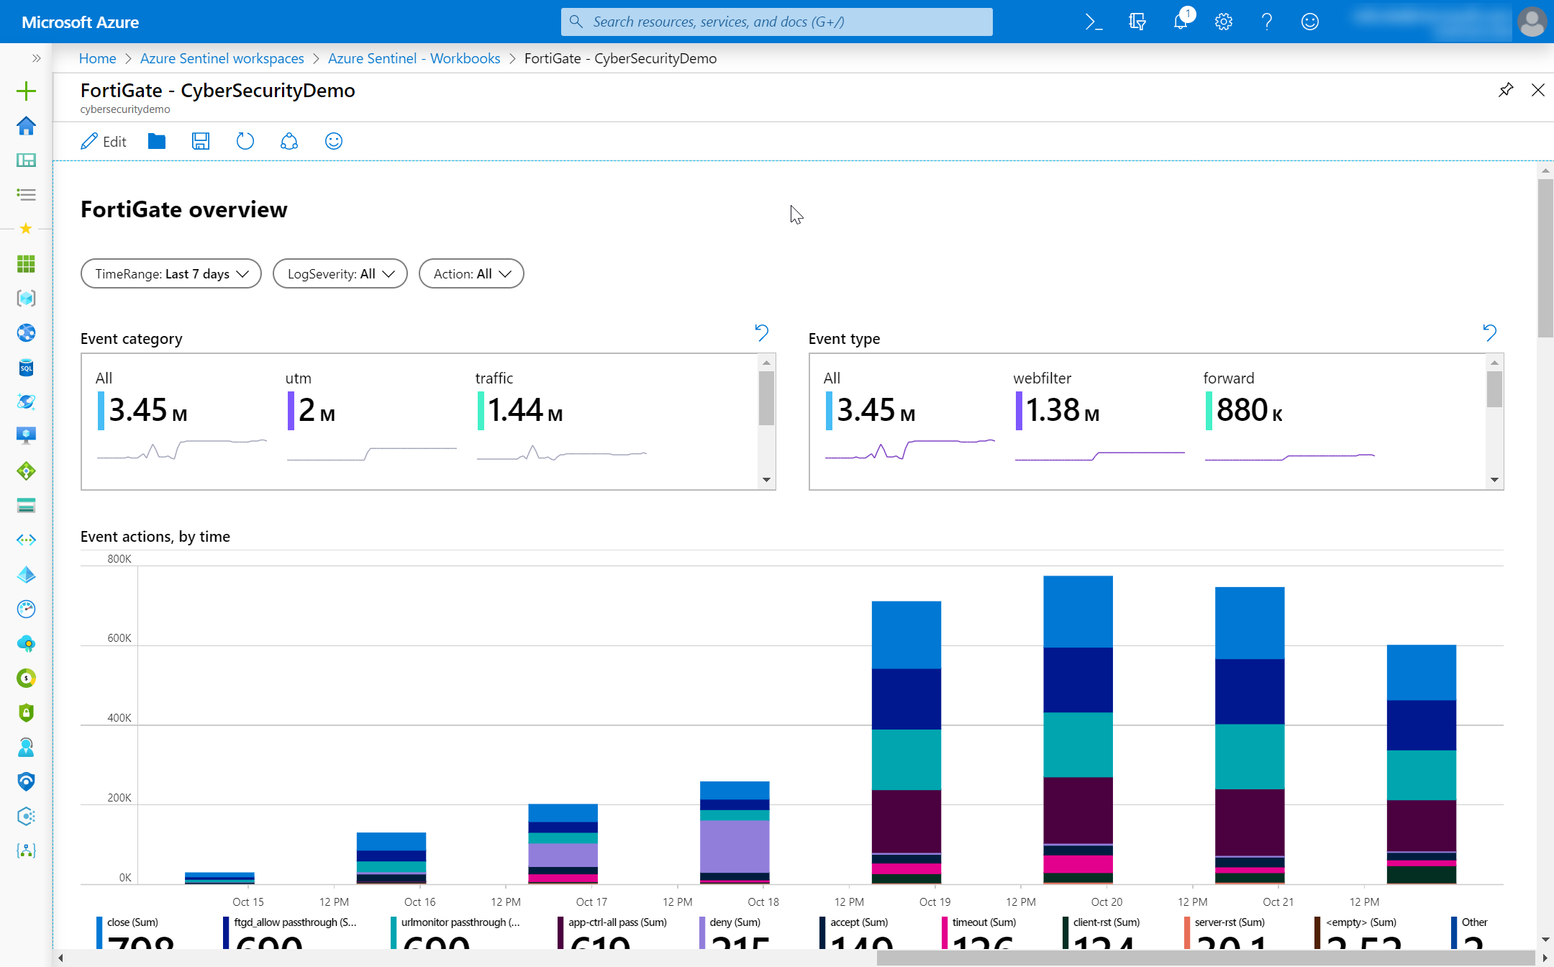
Data visualization
Monitor your data and activity
Use built-in workbooks
Use Power BI for external users
Notes:
Once your data is flowing in, you can gain instant insights as I mentioned earlier, and workbooks are one way to do that. Most data connectors come with workbooks and there is a gallery of workbooks you can leverage as well built by both Microsoft and the community.
You can also take advantage of rich visualization options, combining multiple kinds of visualizations – including graphs and maps in a single dashboard. Keep in mind these are interactive views, allowing you to pivot and interact with your data.
And you can use them to provide deep insights into a single data source, but where they truly become powerful is when you combining multiple sources.
Your workbooks are powered by Kusto Query Language, or KQL. KQL is the query syntax used in Log Analytics and Azure Data Explorer. This means that if you already know KQL, you can accelerate into building and customizing workbooks and if you are new to KQL you'll be able to reuse what you learn about KQL across other Azure services.

Slide 25
Demo
Creating a custom workbook using Azure Monitor workbooks

Slide 26
Security orchestration

Slide 27
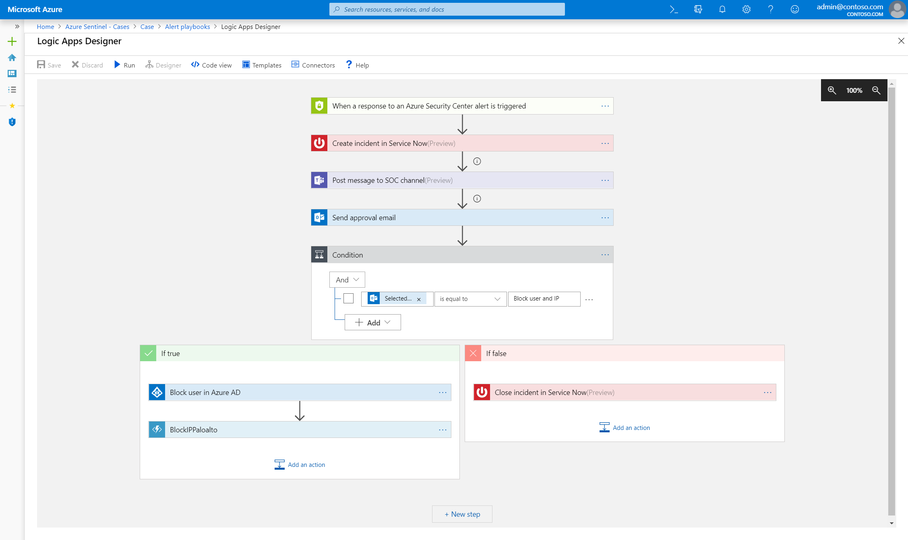
SOAR
Reduce your workload with automation
Use GitHub templates
…. and share your workbooks back!

Slide 28

Automated incident response
Build automated and scalable playbooks that integrate across tools
Choose from a library of samples
Create your own playbooks using 200+ built-in connectors
Trigger a playbook from an alert or incident investigation
Notes:
Automation and orchestration for Azure Sentinel is powered by Azure Logic Apps and fully integrated with Azure Sentinel with 200+ built-in connectors plus generic connectors like HTTPS in Logic Apps.
You can build automated and scalable playbooks that integrate across tools, choose from a library of samples or create your own using the connectors I mentioned, and you can trigger a playbook from an alert or incident investigation which provides you the flexibility to automate across your SOC.

Slide 29



Example playbooks
Incident Management
Enrichment + Investigation
Remediation
Assign an Incident to an Analyst
Open a Ticket (ServiceNow/Jira)
Keep Incident Status in Sync
Post in a Teams or Slack Channel
Lookup Geo for an IP
Trigger Defender ATP Investigation
Send Validation Email to User
Block an IP Address
Block User Access
Trigger Conditional Access
Isolate Machine
Notes:
I'd also encourage you to think about automation and playbooks beyond the scope of remediation. There are a number of other use cases for playbooks.
For example, consider incident management. Automation allows you to assign an incident to an analyst, open a ticket in your ITSM system such as ServiceNow, keep incident data in sync, or even post a message to a Teams or Slack Channel.
Next, let's consider enrichment and investigation. For example being able to look up a geography for an IP captured in your logs, trigger a Defender ATP Investigation, or even something as simple and light touch as sending a validation email to an end-user.
Finally, for remediation, consider examples such as being able to block an IP address (even in your on-prem firewall) or disable user access using the Graph API. You can also trigger conditional access or perform actions such as isolating a virtual machine so you can perform more analysis on it where it can no longer impact your environment.

Slide 30
Demo
Automating incident response with playbooks

Slide 31
Thank you.
Notes:
Thanks for listening to Securing your Infrastructure with Azure Sentinel.
My name is [Speaker name].

